Slide 5
Executive Summary

Slide 7
DETAILED FINDINGS

Slide 9
DATA PERCEPTIONS
While some respondents are concerned about data collection, others consider this a fact of being online.
I do not mind sharing some data about myself online if it helps the website to recommend content to me such as news or products that I might want to buy, based on previous things that I've looked at. That's quite helpful and saves me quite a lot of time. - 24, Male, Gaming app
Well, I guess I have mixed feelings. On the one hand, if it's used to personalize services I receive, then that's a good thing. On the other hand, there is a great concern that data can be accessed by hackers and could be used for fraudulent purposes or to scam me, so I'm not keen on that, at all. - 57, Male, Messaging app
Don't particularly like the idea of companies knowing too much information about myself. Perspective employees can search online, trying to find anything about you. Everything is accessible nowadays… I don't really find it very comfortable. - 33, Female, Social media app

Slide 11
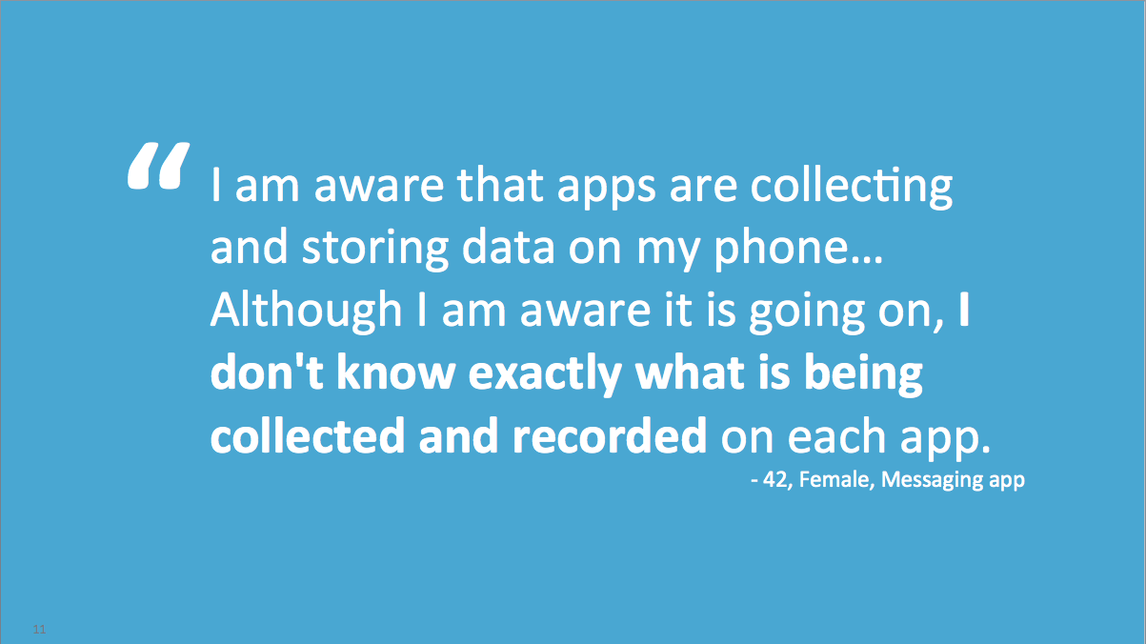

Slide 20
PRIVACY POLICY COMMUNICATIONS
Privacy policies should be concise, easy to find, and in plain language.
I think apps should make sure that their privacy policy is easy to find and easy to understand, and that they should be open about how they're going to use your data. We do need to be aware of what people's data is being used for. - 29, Female, Social media app
I think is really important that companies use plain English to tell what they're going to do with the data that you share with them, and also exactly what things you can opt in and out of, so that you all know exactly where you stand with each other. - 48, Male, Social media app
I think that any new app that I use should have a bullet point process that when you install it, including what information they collect and how would they distribute it, whether they sell it to third parties, giving me a chance to opt out… - 34, Male, Social media app

Slide 23
appendix

Slide 24
APPENDIX: HIGHLIGHT REEL, DATA PERCEPTIONS

Slide 25
APPENDIX: HIGHLIGHT REEL, PRIVACY POLICY COMMUNICATIONS

Slide 26
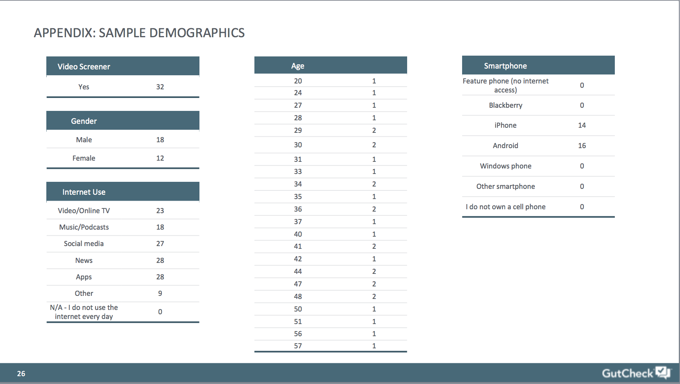

Slide 27
