Slide 10
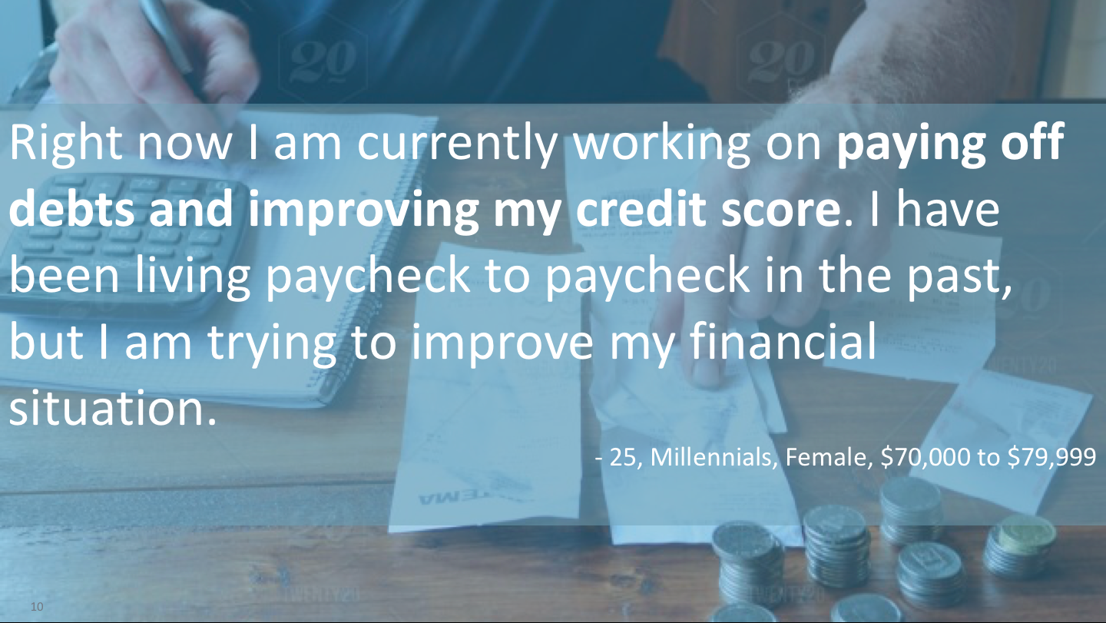

Slide 14
FEELINGS TOWARD CURRENT FINANCIAL PROVIDER
Respondents generally feel positive towards their primary financial provider.
These two videos are highlight reels to provide the most insightful comments in an easily digestible and shareable format. Note: these responses do not encompass all respondent videos in their entirety.

Slide 23
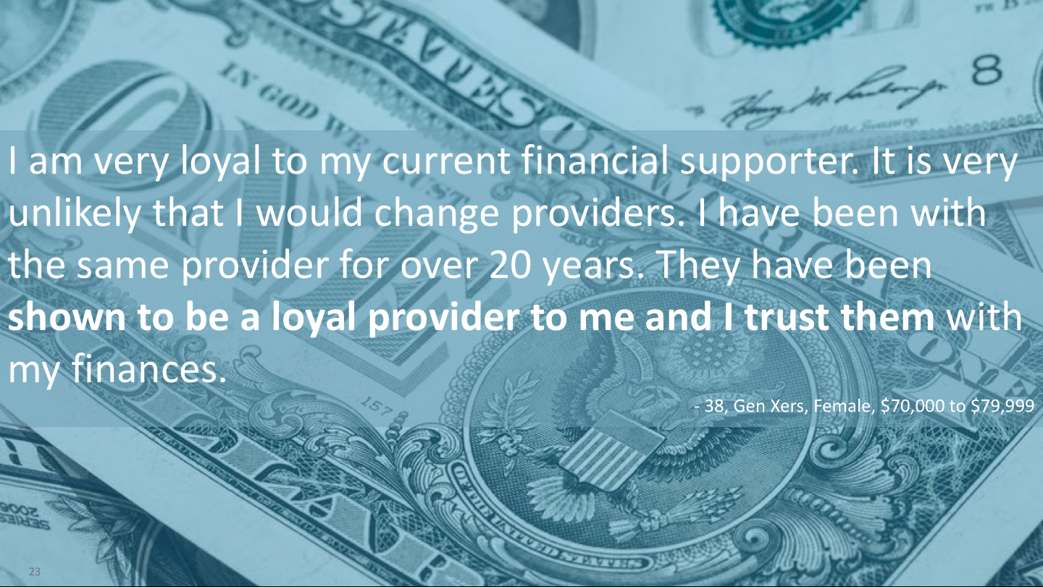

Slide 26
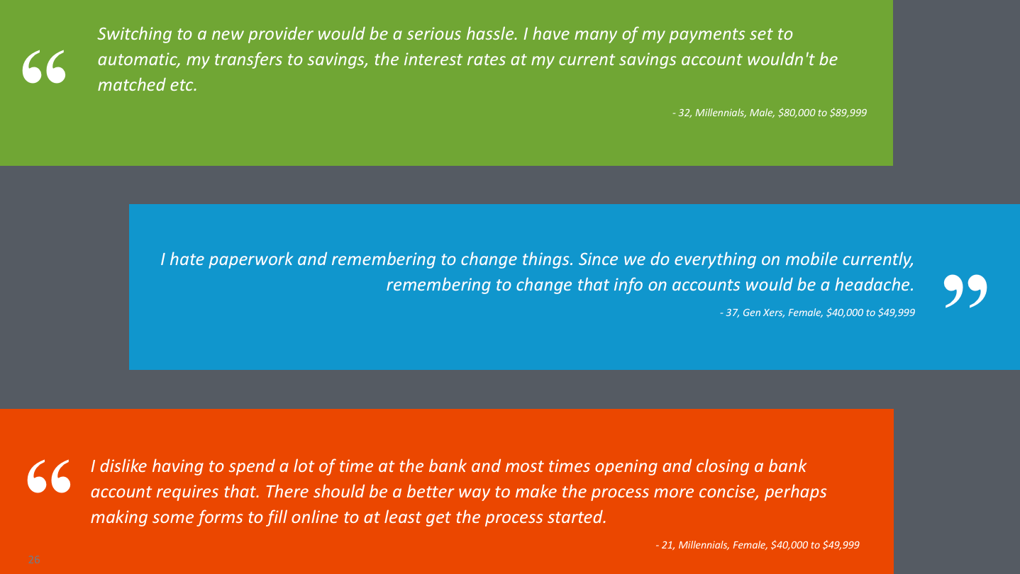

Slide 36
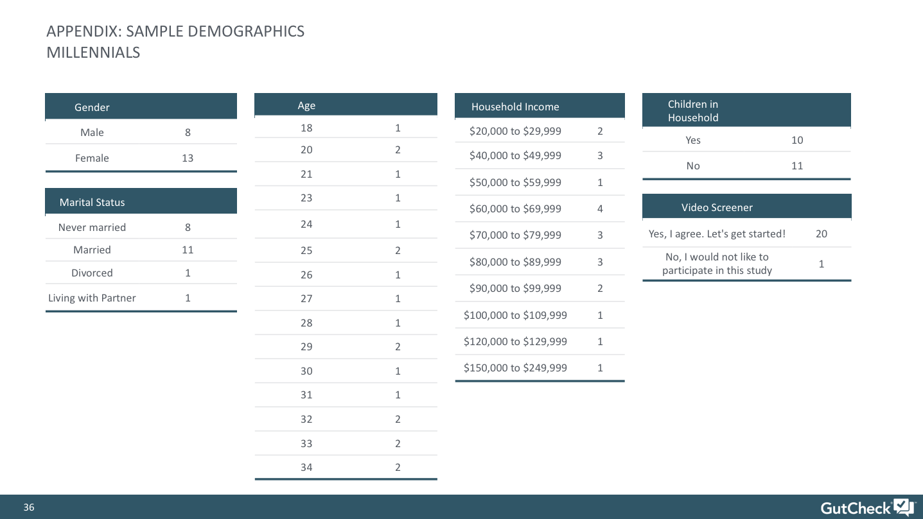

Slide 37
