Slide 4
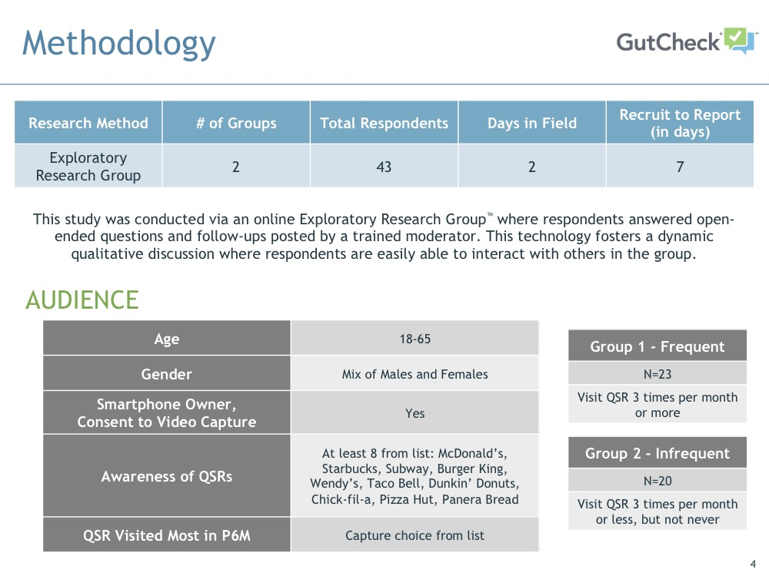

Slide 11
Simple, healthy options kept people coming back
Male, 25, Frequent,
McDonald’s
Female, 29, Infrequent,
Starbucks
Male, 45, Infrequent,
Chick-fil-A
Many people mentioned healthy options were a big reason they return to their favorite QSR
Lower-calorie options like Panera Bread’s salads and Subway’s fresh veggies stood out as healthy choices
Less-processed ingredients like Chipotle’s fresh meats and Chick-fil-A’s lightly breaded chicken reduced guilt from eating fast food
Fresh preparation that is visible helped customers feel they were making good choices with their fast food orders
Simple ingredients (such as whole pieces of chicken) and simple cooking methods appealed to many, and made fast food seem healthier

Slide 12
Specific amenities like drive-throughs, play areas, and loyalty programs tipped the scale for some
Loyalty programs provided some with added incentives to stick with a favorite QSR, and helped keep costs down with free items and discounts
Where available, drive-through service makes a stop at a favorite QSR quicker and easier
Kids’ play areas keep kids asking to come back to a QSR and made parents feel more welcome
Even though online ordering ranked among the 4 least important attributes for both groups, a few people really appreciated being able to order through a mobile app
Female, 33, Frequent,
Panera Bread
Male, 51, Infrequent,
Dunkin’ Donuts
Female, 36, Frequent,
Chick-fil-A

Slide 14
