Slide 4
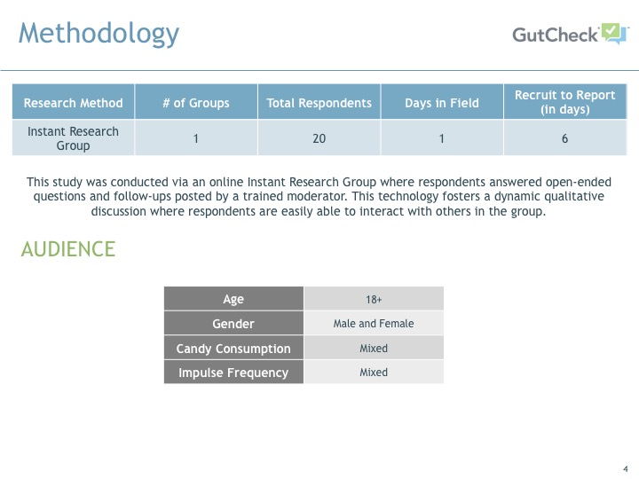

Slide 9
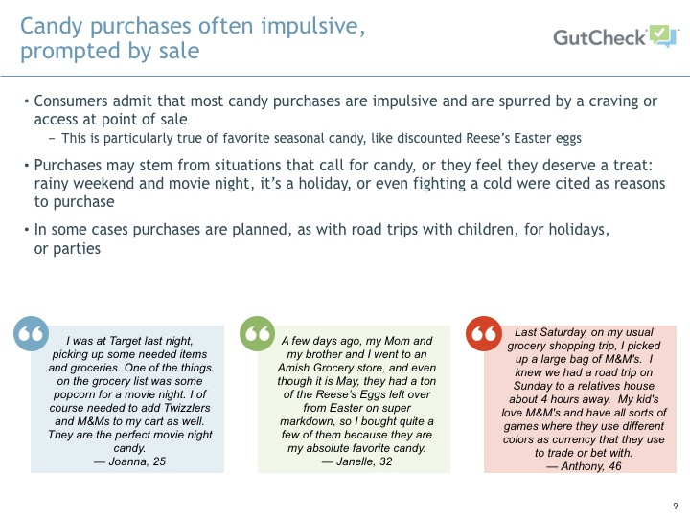

Slide 11
Reese’s Peanut Butter Easter Eggs top the list of favorite candies

Slide 12
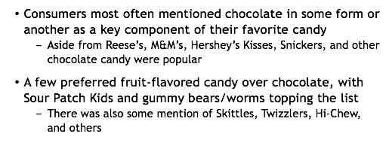
Favorite candy is typically “classic”, most often chocolate

Slide 14
Aside from taste, nostalgia factors heavily into classic favorites

Slide 15
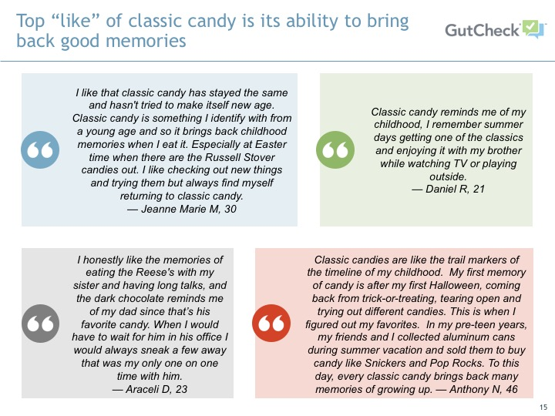

Slide 18
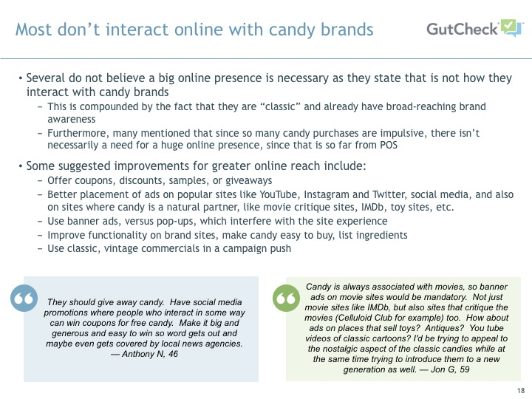

Slide 21
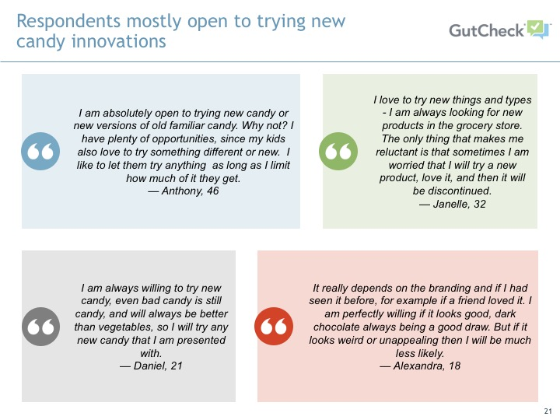

Slide 25
