Slide 5
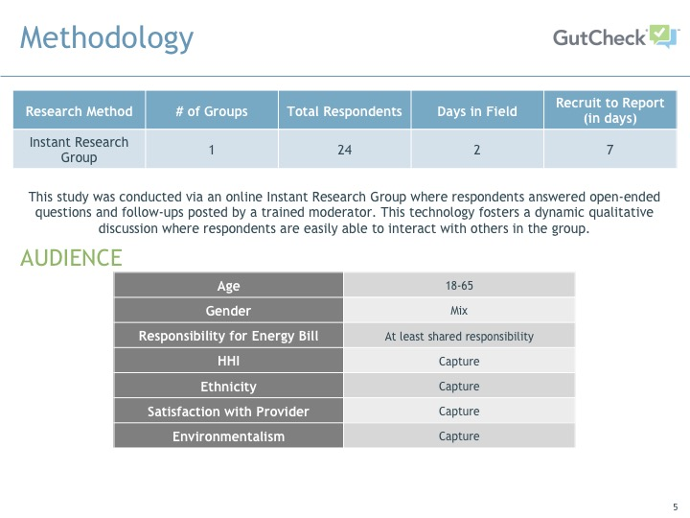

Slide 10
Female, 44, Colorado
Female, 34, Colorado
Female, 24, Minnesota

Slide 11
Male, 41, Colorado
Female, 41, Minnesota

