Slide 3
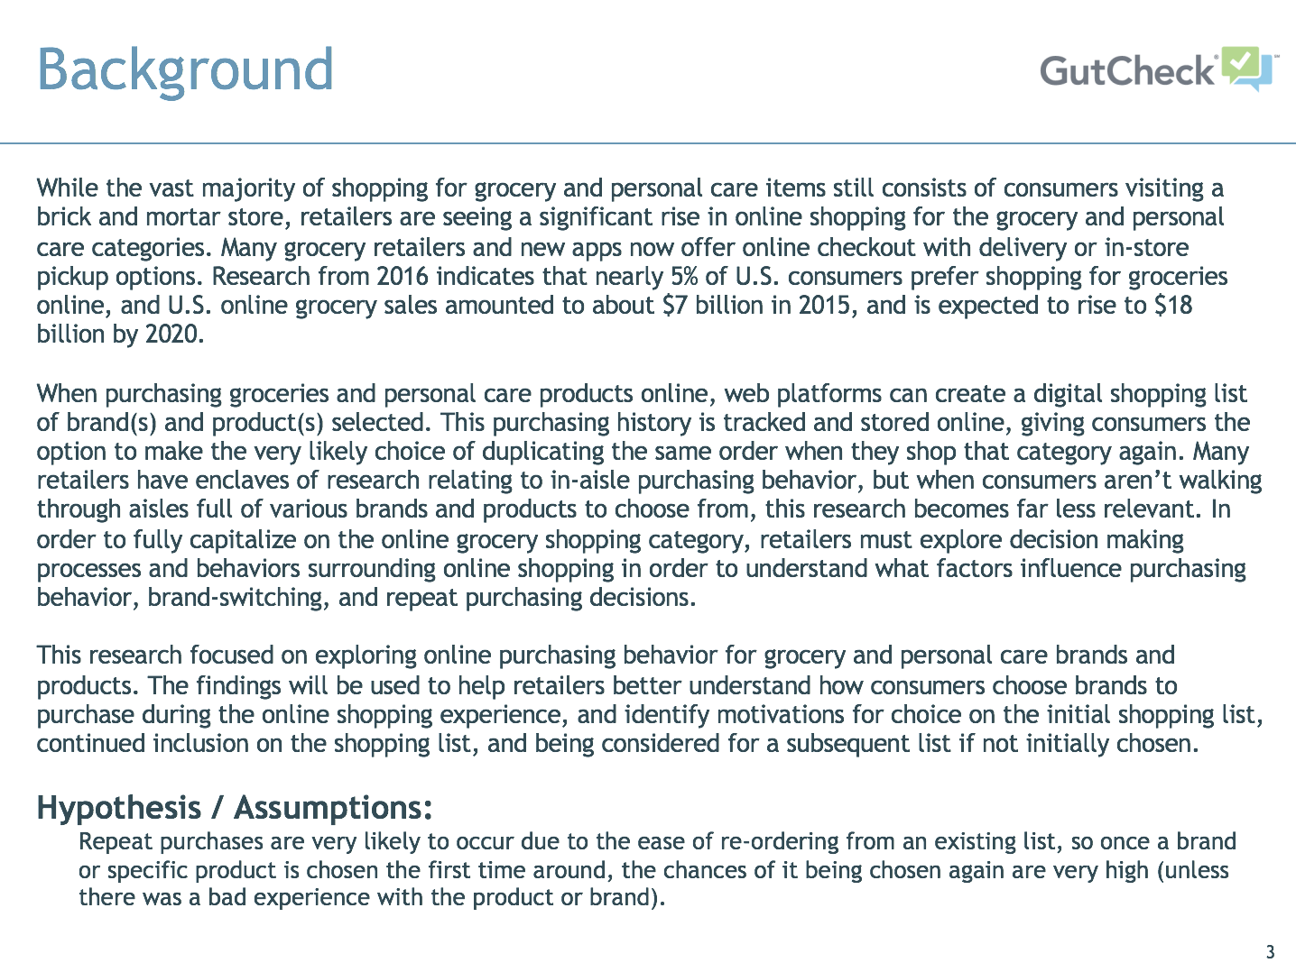

Slide 5
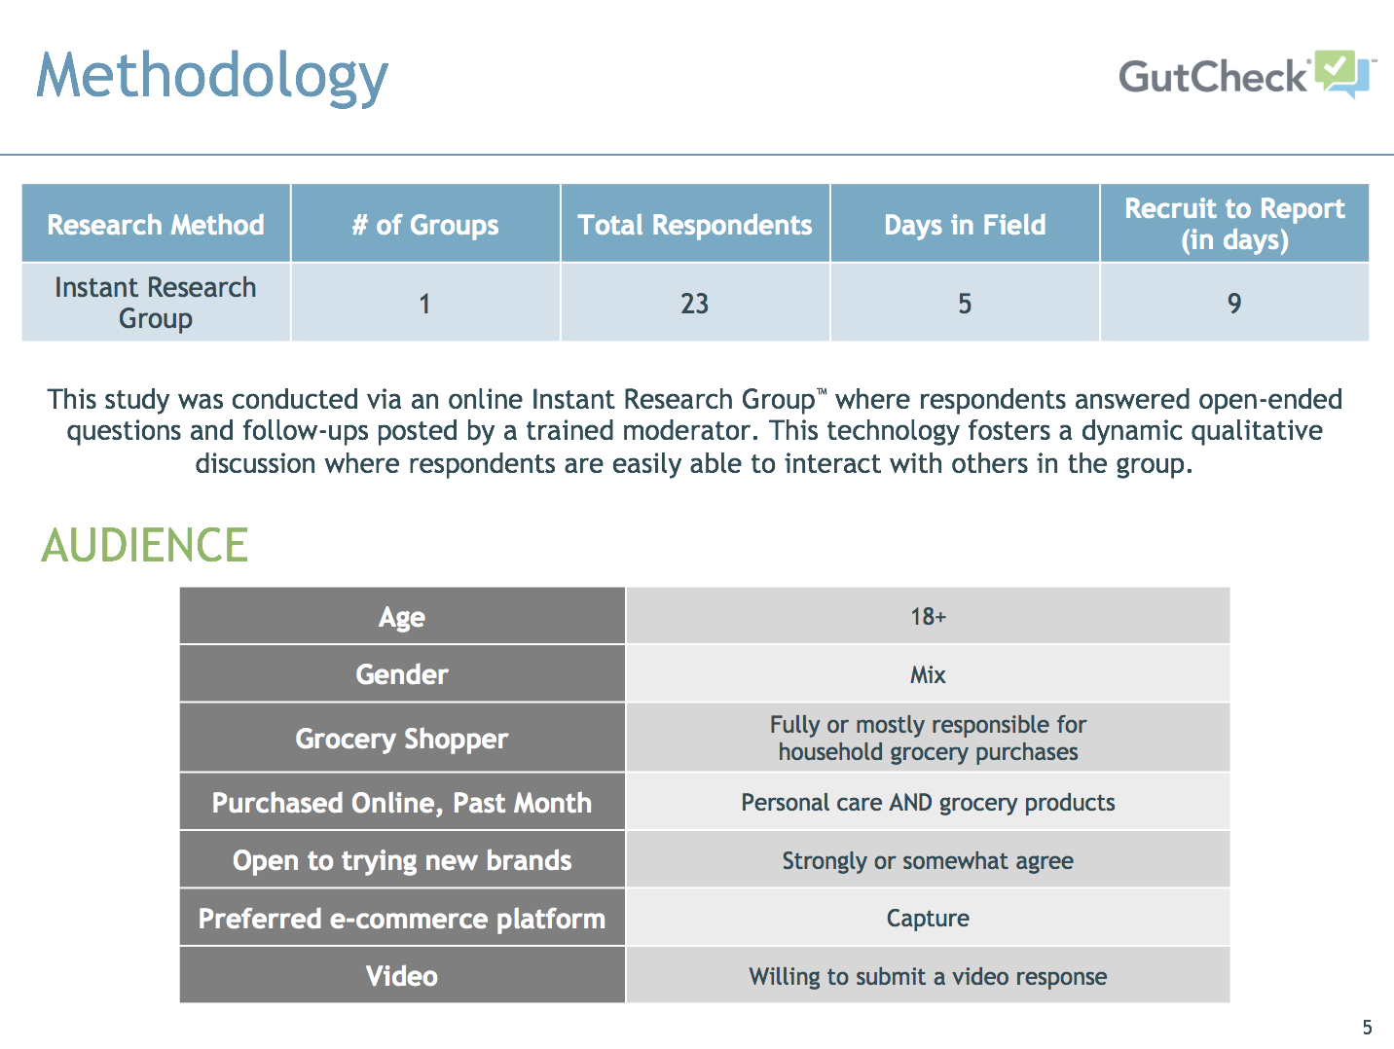

Slide 15
Female, 32, Amazon Grocery
Female, 34, Amazon Grocery
Female, 35, Amazon Grocery

Slide 16
Female, 30, Peapod
Male, 54, Peapod
Female, 25, Amazon Grocery

Slide 18
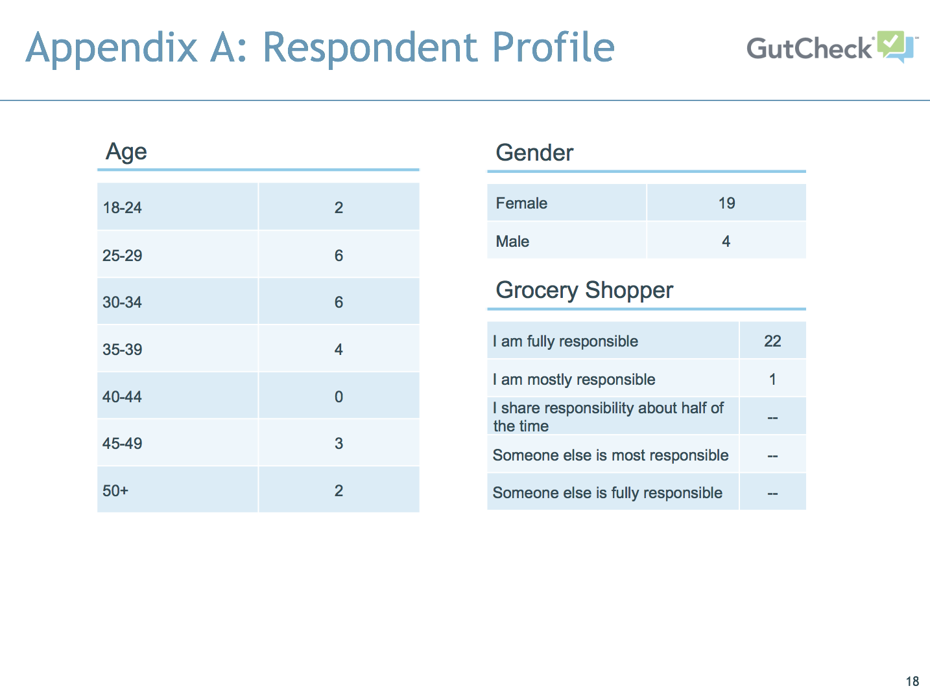

Slide 19
